Slide 1
Welcome to the 2015 ARTEMIS-IA Brokerage Event
Jan Lohstroh
Secretary General
2015 Jan. 21

Slide 2
2014 Call Process for ECSEL
2014 has been a hectic year with 2 parallel calls with only one phase: FPP
Many countries were very late with financial commitments
Many countries introduces very different and sometimes orthogonal eligibility criteria
The WP went to 27 (!) revisions
Outcome of the selection process
Coverage of ES/CPS is lower than our community wished/expected, certainly in IA projects
Was the quality of the proposed projects not good enough?
Alun Foster (ECSEL JU) will give more information

Slide 3
ECSEL Call(s) 2015
MASP 2015 has been endorsed by the ECSEL Governing Board (based on the MASRIA 2015)
WP 2015 is still in discussion
Focus?
Closed topics for IA’s for certain application areas?
It will be a 2-stage approach (PO phase + FPP phase)
Evaluation/selection criteria to be approved
Will be decided on in the Governing Board on Feb. 26
Check in your own country about the details of the eligibility criteria!
Alun Foster (ECSEL JU) will explain the approach
Lessons learnt from previous calls
How to improve the chance of being selected

Slide 4
Other non-ECSEL calls related to Embedded/CyberPhysical Systems
H2020
Werner Steinhögl (European Commission) will inform you
EIT ICT Labs
Current call closes in April?

Slide 5
263 registered participants for this event

Slide 6
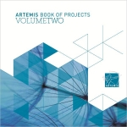
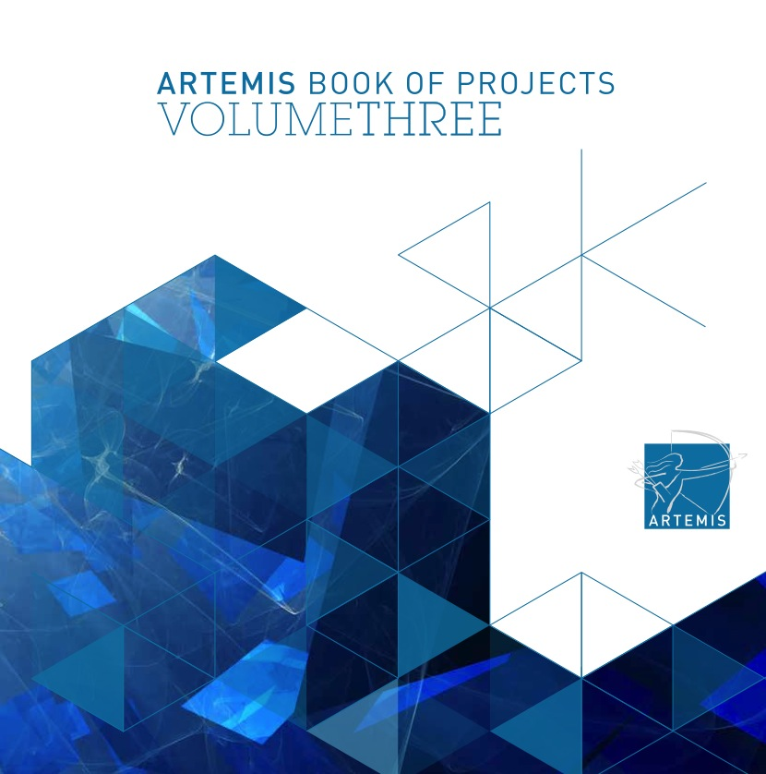
Looking back to ARTEMIS-JU
The third book of projects is available (from two last calls 2013 and 2014)

Slide 7
I wish you a lot of good project ideas and a lot of potential consortium partners! Thank you for your attention

