Slide 1
ECSEL in 2015
Alun Foster
Head of Plans and Dissemination
ARTEMIS-IA and EPoSS Brokerages Amsterdam - 21st - 23rd January 2015

Slide 2
ECSEL in 2015
What is ECSEL about anyway?
Call 2014 outcome
Securing the Future
Call 2015

Slide 3
What is ECSEL?
ECSEL = Electronic Components and Systems for European Leadership
ECSEL JU is:
The Public-Private Partnership keeping Europe at the Forefront of Technology Development

Slide 4
Electronic Components and Systems Provide the “Smart” of Everything
Smartphone
Smart Card
Smart Grid
Smart Cities
Smart Mobility
Smart Governance
….
Smartanything !
“Smart” =
chips
running software,
integrated in a system,
enabling applications !

Slide 5
Summary:
ECSEL JU:
A European funding instrument for RD&I in electronics components and systems
Based on the Public-Private Partnership model
Public sector plus Industry Associations
Using a tri-partite funding model
National, EU and private sector funds
Complementing other funding instruments with a market-facing programme of high impact

Slide 6
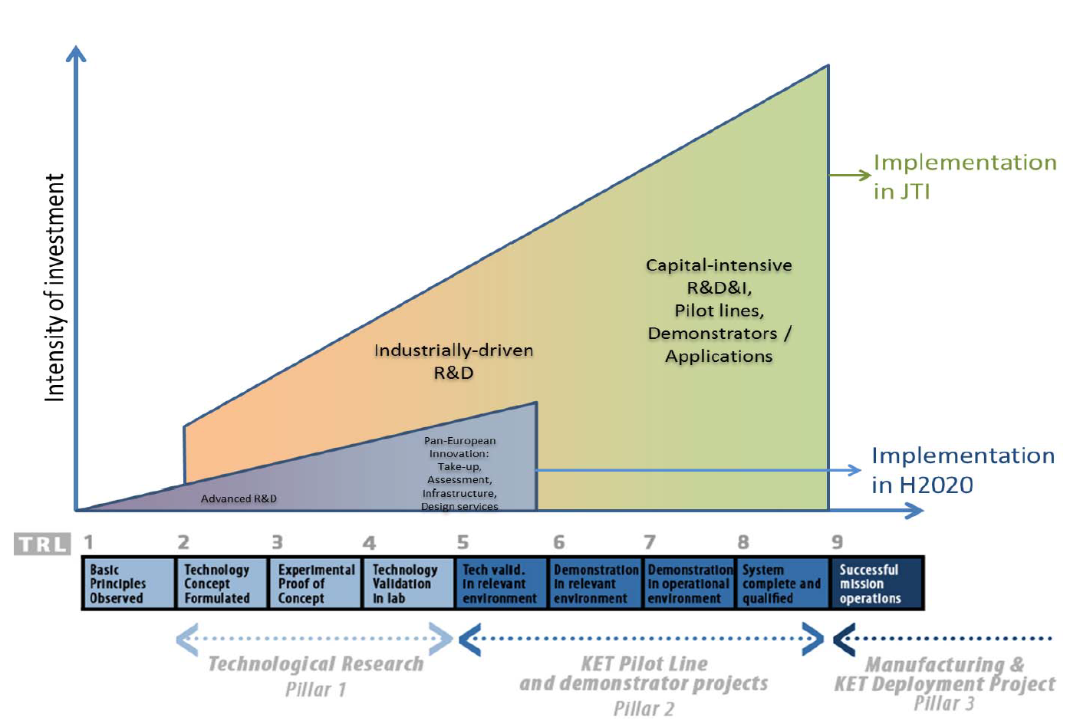
ECSEL JU Shall Drive Innovation by Focusing on Higher Technology Readiness Levels
European Commission, Brussels, 23.5.2013, COM(2013) 298 final

Slide 7
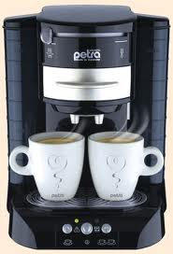
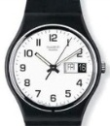
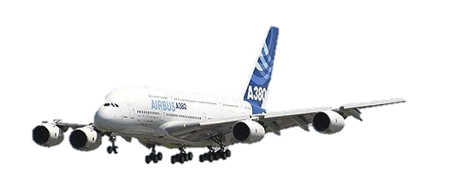
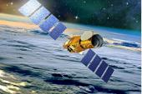
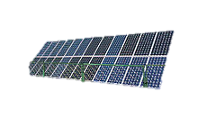
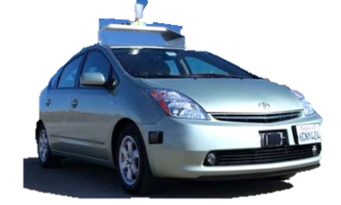
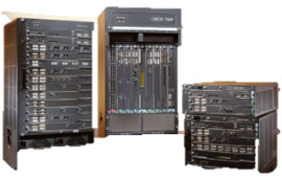
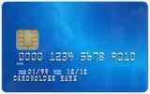
Nanoelectronics Permeates All Aspects of Societal Life,
Drives Innovation in All Industries,
Creates Jobs and Growth
Services
7-10 jobs
20-25 €
ELECTRONICS
Nano
Electronic
Components
1 job
1€

Slide 8
ECSEL JU: an Inclusive Programme
Permeating virtually all industrial branches and aspects of societal life
Bringing together Union, Participating States and the private sector
Allowing participation of large and small countries, of regions
Supporting the whole ecosystem:
Sequoia (large)
Normal trees (medium-sized)
Bushes (small)
Grass-root innovation (institutional / academic research)
Naturally able to combine funding sources (e.g.H2020+ESIF)
H2020: ECSE JUL

Slide 9
The Calls of 2014

Slide 10
Calls 2014 Conclusion
 |  | Call 2014-1: RIA | Call 2014-2: IA | TOTAL
National Grants | Initial budget | 17.5 | 42.5 | 164.5 (104.5 unassigned)
 | Awarded | 39.8 | 104.0 | 143.7
EU Grants | Initial budget | 40 | 95 | 135
 | Awarded | 48.3 | 106.7 | 155.0
TOTAL GRANTS | Awarded | 88.0 | 210.7 | 298.7
Projects Selected for Funding |  | 3Ccar EXIST MANTIS OSIRIS RobustSense SWARMs | ADMONT InForMed POWERBASE R2Power300 SeNaTe WayToGo Fast | 48 FPP submissions 12 projects selected Success rate: 1 in 4
Eligible costs: 708M€ (National), 650M€ (H2020)

Slide 11
Securing the Future

Slide 12
The Tripartite Joint Undertaking: a Mechanism among Many
Industry
CATRENE, ITEA3, ΣURIPIDES2, CELTIC+, EUROGIA+, ACQUEA,
EUREKA Clusters
JTIs /JUs
BBI, Clean Sky, FCH, IMI
Contractual PPPs
EeB, FoF, SPIRE, EGVI, Photonics, Robotics, HPC, 5G
National Programmes
FP7/H2020 Calls
Member
States
Smart Specialization ESIF/ERDF
Regions

Slide 13
Kick-starting access to the Structural Funds
Workshop - “Smart Regional Financing for Key Enabling Technologies (KETs)”
Driven by ECSEL in association with
Held on Nov. 6th in ECSEL JU Office building (White Atrium)
Information workshop to operational staff of regional management offices
Follow-up meeting being planned

Slide 14
Securing the future – Prepare the 2015 Calls
Multi Annual Strategic Plan and Work Plan 2015
MASP adopted in December 2014
Work Plan 2015 to be adopted in February
MASP
MASRIA +
RIAP
WP

Slide 15
Multi-Annual Strategy Research and Innovation Agenda: Basis of the Multi-Annual Strategic Plan
MASRIA 2015 Roadmap:
RIA:
IA:
open
open
open
closed
open
open
open
open
open
closed
The MASP will follow the MASRIA, unless the Public Authorities and/or the Private Members require modifications
RIA:
open
open
open
open
IA:
open
open
open
open

Slide 16
Call 2015 – Decision process
Pending issues:
Balance of EU and National funding
National budget commitments
EU provisionally ~ 145M€ (up from 95M€ original plan)
MASP topics to open for the call
A Working Group is active to refine these
Public Authorities Board plus invited representatives
Final details published after Governing Board meeting on 26 Feb

Slide 17
New in 2015 (compared to Calls of 2014)
2-phase call
PO phase helps to align / improve proposals
Elaborates the “Excellence” and “Impact” criteria
PO is MANDATORY and GATING (!)
Criteria
Same top-level criteria (H2020)
Improved depth and explanation
Briefing of participants and experts
Extended definition of “TRL”
Different interpretations in different industries

Slide 18
Provisional Timeline 2015 – Call and related events
EVALUATIONS
jan
feb
mar
apr
may
jun
jul
aug
sep
oct
nov
dec
Call open
PO closed
FPP closed
Funding decision
ARTEMIS + EPoSS Brokerage
Amsterdam
Aeneas/Catrene ENF
ARTEMIS/ITEA Co-Summit
(Berlin)
EPoSS event (Copenhagen)
Consortium Building Event Brussels (Autoworld)
EPoSS event?
Events | Date / Place
ARTEMIS + EPoSS Brokerage events | 21+22/01 Amsterdam
Call Launch Event | March 2015, Brussels
ARTEMIS/ITEA CoSummit + EPoSS event | 10+11/3/2015 Berlin + Copenhagen
Consortium Building Event | End May / early June 2015
Call Launch Info Event and Brokerage
Brussels

Slide 19
TIPS - I
Non-exhaustive, no guarantees suggestions...
Read the MASP, the WP and especially the criteria and their explanations, and address them
Imagine you are reading the proposal as an evaluator would...
Make sure you can explain in clear terms why your project is really relevant to the programme
Describe what you will do (and why) completely but concisely!
Make it easy to grasp, don’t frustrate with lots of excess detail

Slide 20
TIPS - II
Make the ambition and the budgets match – be realistic
Give confidence that you know what it will take to achieve your goals
... And that the project will be properly managed to that end
Build on other projects’ work (ARTEMIS, ENIAC, EPoSS, ... )
Show that you are not just a “one off” but are contributing to the bigger picture
... but be clear why the prior actions are really relevant to your story (be specific)
Tell the ‘story’ of your project to a non-specialist
If they can understand and are enthusiastic, it’s probably OK

Slide 21
Motto:
“When the object is to raise the permanent condition of a people,
small means do not merely produce small effects:
they produce no effect at all.”
John Stuart Mill (1806-1873) “The Principles of Political Economy”
So ... Please help us to both
THINK BIG and to ACT BIGGER

Slide 22
Thank you!

Slide 23
Backup
TRL description for hardware and software

Slide 24
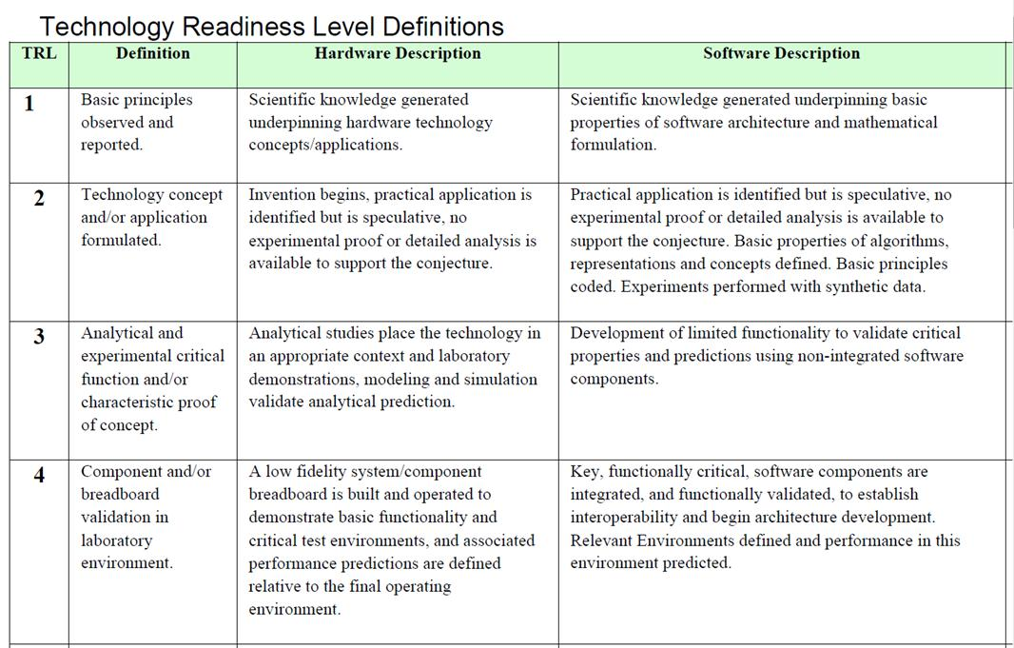
Research and Innovation Actions

Slide 25
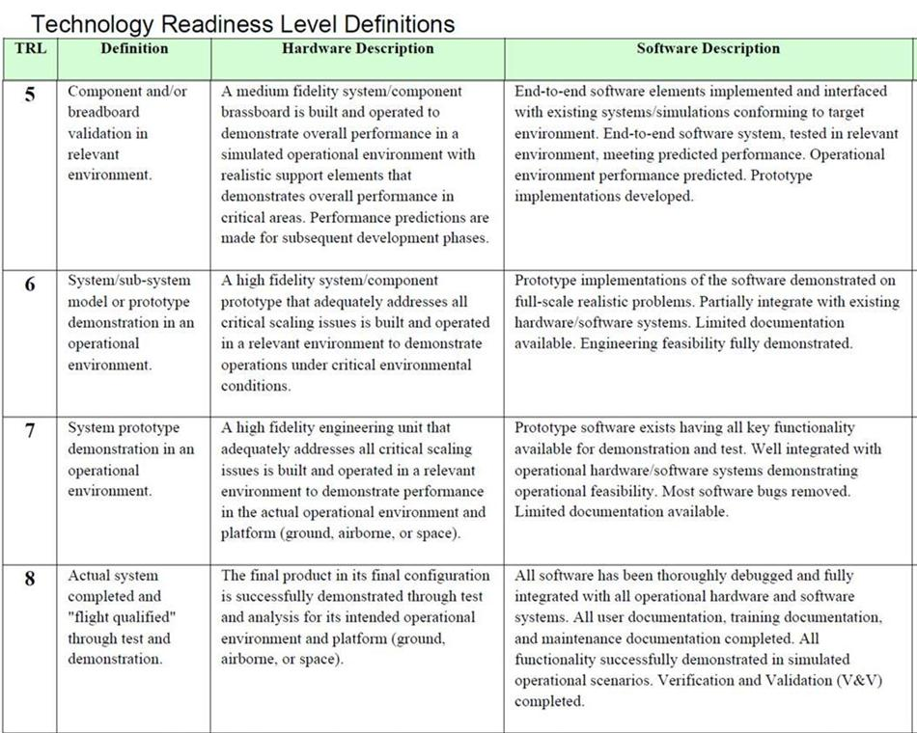
Innovation Actions

Slide 26
This is Deployment

