Slide 1
ARTEMIS Brokerage 2015 Organisation
Ad ten Berg, Office Director, ARTEMIS-IA
January 21-22, Amsterdam, The Netherlands
#Brokerage2015

Slide 2
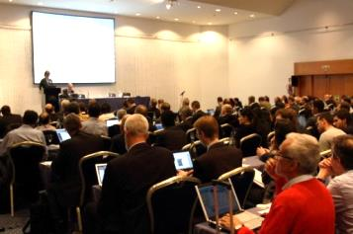
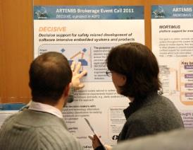
Maximal visibility for your project idea:
Before Brokerage:
Enter your project idea in Project Idea Tool (PIT)
At Brokerage event:
Pitch of project ideas in plenary
Poster session on project ideas
Break-out session to discuss project
Update your project idea in PIT
Communicate project status through:
#Brokerage2015

Slide 3
#Brokerage2015
Twitter messages with #Brokerage2015
will be visible at TweetDeck on the
Project idea status screens
You can post important messages regarding project ideas such as:
Meeting location
Status project etc.

Slide 4
Project Idea Tool: PIT
PIT: https://office.artemis-ia.eu/idea/
Personal deeplink or Login required:
Deeplink in recent mail to all registrants
Upload project idea with documents and powerpoints
Information share-point for this event

Slide 5
Project Idea Tool (PIT)
PIT for Preparation purposes
PIT for Updates of Project ideas (incl. presentation)
* during the Brokerage *
PIT to get an Overview of all Brokerage results
PIT is source for -> The information screen at the event

Slide 6
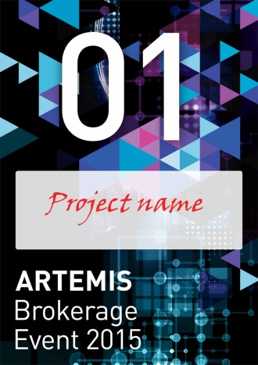
Sessions
Plenary:
Project idea pitch in plenary session
Poster session:
for initial discussions and getting more information on project idea
Break-out sessions:
All meeting rooms have a color code
All projects have a number (see sign posts)

Slide 7
Break-out & Plenary sessions:
No session moderators in Break-outs
Interactive location of project-meeting on information-screens
Share your information through the TweetDeck
Plenary session with presentation of all ideas in PIT tool
at the end of Day 1 and 2
This brings all at the same level of information
Focus is on missing expertise or partners
What does your proposal need?

Slide 8
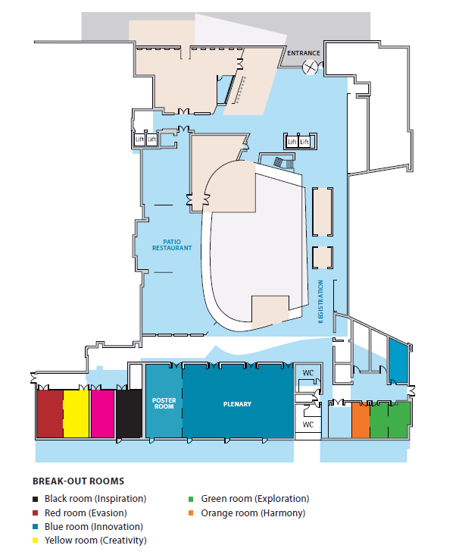
Floorplan
Find a project meeting:
Look for :
room colour
project idea number

Slide 9
Agenda Day 1 Wednesday 21 Jan, 2015
10:00 - 10:10 | Welcome & plenary opening by Jan Lohstroh
10:10 - 10:35 | MASP ECSEL JU by Andreas Wild/ Alun Foster
10:35 - 10:55 | ICT calls in H2020 LEIT by Werner Steinhoegl
10:55 - 11:05 | Organisation of this event & Introduction to participants by Ad ten Berg
11:05 - 11.30 | Coffee break
11:30 - 13:00 | Plenary project idea presentations
13:00 - 14:00 | Lunch & Poster Session
14:00 - 14:30 | Poster Session
14:30 - 16:30 | Breakout session 1 - Reserved meeting tables
16:30 - 17:00 | Coffee break
17:00 - 18:00 | Plenary project idea presentations
18:00 - 22:30 | Grand dinner

Slide 10
Agenda Day 2 Thursday 22 Jan, 2015
09:00 - 09:30 | HiPEAC by Marc Duranton
09:30 - 10:00 | SPIRE by Loredana Ghinea
10:00 - 10:15 | Coffee break
10:00 - 12:15 | Breakout session 2
12:15 - 13:30 | Lunch & Poster Session
13:30 - 15.00 | Breakout session 3
14:00 - 15:00 | Coffee break
15:00 - 16.00 | Plenary project idea results presentation
16:00 | Closure

Slide 11
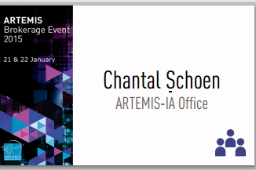
Network dinner 21 January
Dinner:
18:00 leaving from Entrance hotel Steigenberger:
Entrance only with dinner notification on the badge.
Scan QR code to go directly to the Brokerage presentations

Slide 12
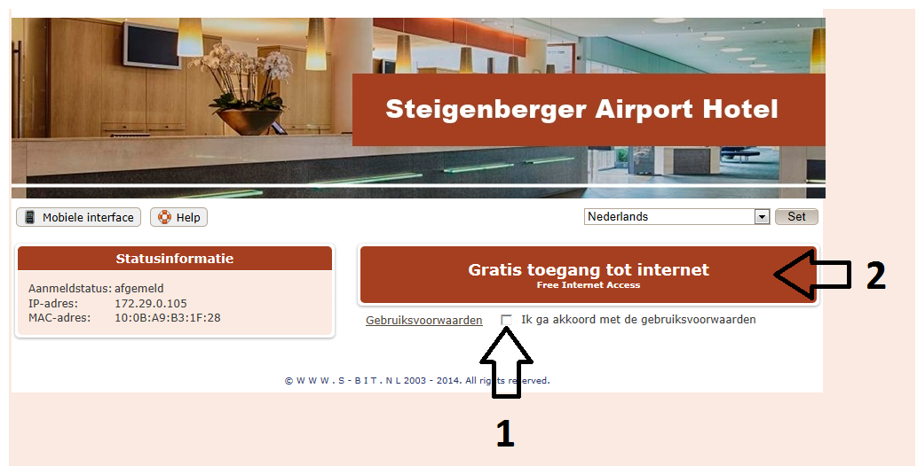
Internet access
Network: WiFi
Password: not needed, Free internet

Slide 13
Thank you
Ad ten Berg
Email: a.ten.berg@artemis-ia.eu

