Slide 1
SPIRE PPP
- Sustainable Process Industries
through Resource & Energy Efficiency -
www.spire2030.eu

Slide 2
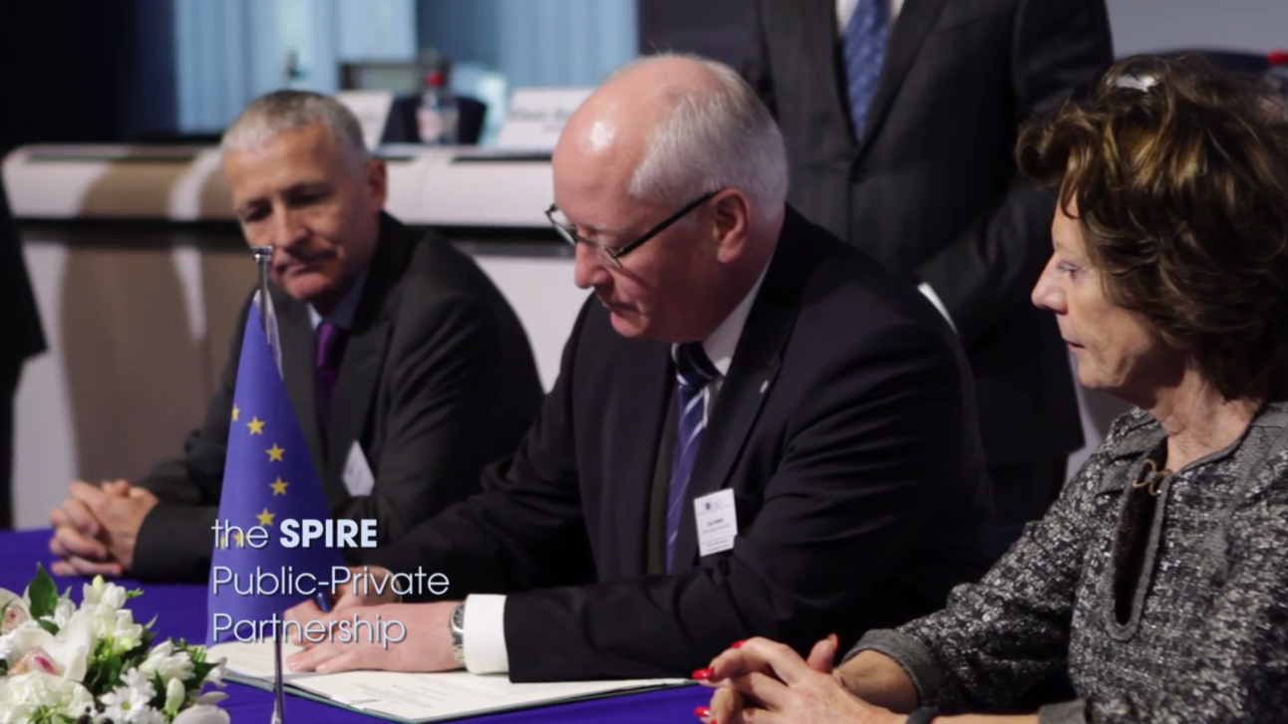
SPIRE PPP
Officially launched on 17 December 2013 in the framework of HORIZON2020
First-ever 7-year innovation Public-Private Partnership (PPP) with Europe’s process industry

Slide 3

STEEL
METALS
WATER
CHEMICALS
CEMENT
MINERALS
ENGINEERING
CERAMICS

Slide 5




The value chain
Raw Materials
Process Industry:
Chemical, biochemical, and physical transformation and formulation of raw materials using continuous and batch processes into Materials with new properties and functionalities
Discrete Manufacturing:
Components
& Products

Slide 6

HORIZON2020
Horizon 2020
Excellent
Science
Future Emerging Technologies
Industrial Leadership
Advanced Materials&Nano
Advanced Processes
Biotechnology
Societal
Challenges»
Energy
Climate Change - Waste
Bioeconomy

Slide 7
SPIRE Roadmap
Part 1: Vision
A Sustainable Process Industry for a resource-efficient and low-carbon economy: Rejuvenate the European process industry base and help decoupling economic growth from resource impact
Part 2: Research and Innovation Strategy
6 Key-components: Feed, Process, Applications, Waste2Resources, Horizontal and Outreach
Part 3: Expected Impacts
Up to 30% reduction in fossil energy intensity from current levels
Up to 20% reduction in non-renewable, primary raw material intensity compared to current levels
Up to 40% improvement in CO2-equivalent footprints
Leveraging additional investments

Slide 8






PROCESS INDUSTRY
STRATEGIC AGENDA
REDUCE with SPIRE
Within the existing installed base of industrial processes
Reduce feedstock: enhance the availability and quality of existing resources
Reduce emissions
Reduce energy and water: integrated use, new materials
Reduce, prevent waste

Slide 9

PROCESS INDUSTRY
STRATEGIC AGENDA
RE-USE with SPIRE
Within the existing installed base of industrial processes
Re-use energy within and between different sectors:
energy harvesting, storage and re-use
Re-use water within the sector and within the area
Re-use waste streams as feed, including recovery, recycling and
re-use of post-consumer waste; waste system approach – new business models

Slide 10


PROCESS INDUSTRY
STRATEGIC AGENDA
REPLACE with SPIRE
Within the existing installed base of industrial processes
Replace current feedstock by integrating novel and renewable feedstock (such as bio-based) to reduce dependency while reducing the CO₂ footprint of processes or increase the efficiency of primary feed stock.
Replace current inefficient processes

Slide 11




PROCESS INDUSTRY
STRATEGIC AGENDA
RE-INVENT with SPIRE
Rejuvenate & invest in industrial processes
(Re-)invent feedstock
(Re-)invent more efficient equipment
(Re-)invent devices for better monitoring, control & optimisation
(Re-)invent energy & resource mngt. concepts, incl. industrial symbiosis
(Re-)invent materials & products with a significantly increased impact on resource & energy efficiency down the value chain: transport, housing
(Re-)invent technologies for valorisation of waste streams

Slide 12
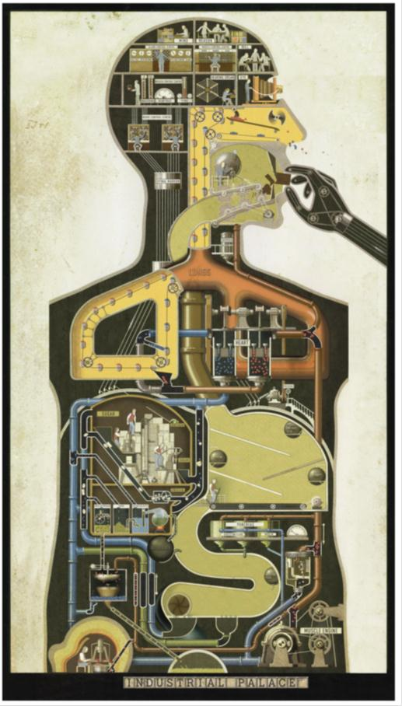
The industrial palace
Feed/raw materials
Process
Application/materials
Waste
Energy, control, environment

Slide 13
SPIRE calls 2014
Total EC funding: €116,3 million
NMP (60,3 M€) – deadline March 2014
  1 topic RIA
  2 topics IA
  1 topic CSA
Energy (12 M€)
  1 topic IA (8 M€) – deadline March 2014
  1 topic RIA (est. 4 M€) – 2 stages: deadlines April/September 2014
Environment (44 M€) – 2 stages: deadlines April/September 2014
  1 topic IA

Slide 14
SPIRE-1: Integrated Process Control
TRL 3-5, RIA 100%
  Specific Objective: Fast in-line data collection and data treatment techniques for improved "near real-time" closed-loop control concepts allowing an integrated economic, ecological and safety optimisation of the processes
  Scope:
  Novelties in:
  Sensor technologies (fast in-line, dynamic information, spatially resolved information, sensors for intensified processes,…)
  Process data treatment (dynamic info, spatially resolved info, data management for optimisation, etc.)
  Process data mining and process knowledge extraction
  R&D to address:
  Miniaturised and cross sectorial application of PAT & PPMT
  Methodologies for extensive integration of control systems
  New (soft-)sensors and sensing concepts, swarm sensors, disposable sensors,…
  Control strategies using integrated and validated PAT data
  Life cycle management
Discrete Manufacturing:
  Expected impact:
  Improvement of real-time measurement of properties of process streams, and of European PAT and Control technologies
  Improved process operation (efficiency, sustainability, reliability, safety, monitoring, resource and energy efficiency, GHG)
Components
& Products

Slide 15
SPIRE-2: Adaptable industrial processes allowing the use of renewables as flexible feedstock for chemical and energy applications
TRL 5-7, IA 70%
  Specific Objective: Develop technologies able to support a significant increase in the utilisation of biomasses and/or re-processing of residues and waste gases in the Process Industry
  Scope (see call text):
  Development of integrated systems for biomass, residues and waste gas conversion, including downstream equipment.
  Provide significant increase in the utilisation of renewables in industry and re-processing of residues and of waste gas
  Lead to new streams suitable for further industrial processing for production of chemicals and/or fuels
  R&D to address:
  Mobile, Flexible and Scalable technologies, allowing (pre-) processing of biomass, residues, waste gases
  Solution should be able to cope with the fluctuating nature (in availability and quality) of renewables
  Business feasibility of the technologies
  LCA and LCC analysis
  The technologies proposed should allow the processing of of significant amount of biomass, residues and waste gases
  Substantial demonstration activities are expected
  Desirable: Multi sectorial approach and replicable methodology
Discrete Manufacturing:
Components
& Products

Slide 16
SPIRE-2: Adaptable industrial processes allowing the use of renewables as flexible feedstock for chemical and energy applications
TRL 5-7, IA 70%
  Expected impact (see call text):
  The technologies proposed should allow a 30% decrease in fossil resources utilisation compared to current practices
  Provide opportunity for increased utilisation of renewables as feedstock for chemicals and fuels production
  Contribute to lowering industrial GHG emissions
  The technologies proposed should provide opportunity for integration in the current industrial landscape
  The concepts should provide direct or indirect impact on rural areas.
Discrete Manufacturing:
  Significant SME participation is encouraged.
Components
& Products

Slide 17
SPIRE-3: Improved downstream processing of mixtures in process industries
TRL 5-7, IA 70%
  Specific Objective: The aim is to provide innovative solutions for downstream processing, advance in the integration of different separation techniques into complex hybrid units and provide tools for the design of such units.
  Scope (see call text):
  Compatibility with continuous processes and support for the transition from batch processes to more efficient and reliable continuous operations (where relevant).
  Reduction of production costs and time to market by providing tools for process and separation unit design and optimisation.
  Significant improvements in energy and resource efficiency.
  Significant reduction in greenhouse gas emissions.
  Improvement in safety of the work environment.
Discrete Manufacturing:
  Expected impact:
  Novel and cost effective separation and fractionation technologies applicable to the process industry.
  Increasing the resource and energy efficiency for the process industries by at least 20% while leading to a significant decrease in greenhouse gas emission.
  Strengthening the competitiveness of the European industry developing both engineering know-how as well as economically sustainable industrial processes leading to shorter time to process/market, and higher production capacity.
Components
& Products

Slide 18
SPIRE-4: Methodologies, tools and indicators for cross-sectorial sustainability assessment of energy and resource efficient solutions in the process industry
CSA 100%
  Specific Objective: Increase the European knowledge base related to applied sustainability assessment tools, methodologies, indicators and to overcome the bottlenecks for cross-sectorial take-up and further development in the process industry.
  Scope:
  The study should include:
  A comparative overview of current methodologies, tools, indicators and practices in different sectors
  A selection of the most appropriate solutions, based on their demonstrated robustness
  An overview of the related opportunities as well as the bottlenecks towards further development and cross-sectorial replication/transfer
  Definitions of the required steps to accelerate further uptake of resource efficiency indicators over the value chains
  Recommendations on the most suitable tools for management and decision making
  Recommendations for further research and development projects in the field of sustainability assessment
  Collaboration with standardisation
Discrete Manufacturing:
Components
& Products
  Expected impact :
  Identification of best practices for cross-sectorial environmental, social and economic sustainability indicators
  Identification of research needs within the process industry
  Identification of cross-sectorial tools for management and decision making within the process industry

Slide 19
SPIRE Energy & Environment calls
EE18: New technologies for utilization of heat recovery in large industrial systems, considering the whole energy cycle from heat production to transformation, delivery and end use (TRL4-7, RIA 100%)
LCE 2 – 2014: Solar cooling systems (TRL3-4 to 5-7, RIA 100%)
WASTE-1-2014: Moving towards a circular economy through industrial symbiosis (IA 70%)

Slide 20
Preliminary results SPIRE 2014 NMP calls

Slide 21
SPIRE 2014 awarded projects
(starting January 2015)
SPIRE 1
  RECOBA
  ProPAT
  DISIRE
  CONSENS
SPIRE 2
  SteamBIO
  MethCO2
  MOBILE FLIP
  EE18
    TASIO
SPIRE 3
  PRODIAS
SPIRE 4
  STYLE
  SAMT
  MEASURE

Slide 22
SPIRE 2014 calls

Slide 23
SPIRE calls 2015
Total EC funding: €89 million
NMP (77 M€)) – deadline 9 December 2014
  2 topics RIA
  2 topics IA
Energy (12 M€)
  1 topic IA (8 M€) – deadline 9 December 2014
  1 topic RIA (est. 4 M€) – 2 stages: deadlines September 2014 / March 2015

Slide 24
SPIRE-5: New adaptable catalytic reactor methodologies for Process Intensification
TRL 3-5, RIA 100%
  Specific Objective: The reduction of the number of steps and unit operations in industrial processes is a key factor in achieving process intensification, improving the efficiency in the use of resources, and reducing the impact on the environment. Continuous scalable processes using intensified equipment are key to enable flexible and decentralized production at high process performance.
  Scope:
  To develop new adaptable reactor concepts by the re-design and merging of critical reaction steps
  To design the corresponding reactor equipment
  To explore the integration and optimization in relation to the full process engineering assessment
  Impact should be proven through process modelling and assessment and quantified in terms of reduction of resources and emissions
  Proposals should include an outline of the initial exploitation and business plans
Discrete Manufacturing:
  Expected impact:
  Reduction of at least 15% in process energy intensity and material resource use
  Reduction of at least 15% in emissions (compared to sota)
  Significant improvements in the flexibility and productivity
Components
& Products

Slide 25
SPIRE-6: Energy and resource management systems for improved efficiency in the process industries
TRL 4-6, RIA 100% (SMEs encouraged)
  Specific Objective:
  Sharing resources (plants, energy, water, residues and recycled materials)
  Integration of multiple production units across different sectors of the process industry
  Gain a better mutual understanding of the operation of the different process industry sectors
  Aim to reach a strong cross-sectorial interactions, to improve the sustainability of the process industry
  Development of holistic measurements and activities.
  Scope:
  Development of Analysis and optimization tools for flexible energy use and material flow integration. Including, widely applicable software
  Rapid transfer from lab-scale into demonstration sites. Pilot tests are expected to address integrated solutions and tools in the specific conditions of real production units
  New approaches that allow cost-saving optimization of energy and resources (e.g. reducing residues, minimizing waste)
  Prototypes and pilots in real industrial settings represent a clear added value
Discrete Manufacturing:
Components
& Products
  Expected impact:
  Significant gains in sustainable processing (resource efficiency, energy efficiency and the emission performance)
  Optimisation of interdependences and the identification of technology components allowing a breakthrough
  Reduction of the overall costs in energy intensive industries by at least 15%

Slide 26
SPIRE-7: Recovery technologies for metals and other minerals
TRL 5-7, IA 70% (SMEs encouraged)
  Specific Objective:
  To develop novel integrated recovery processes that will result in increased resource efficiency and sustainability for the European industry.
  The recovery of significant amount of metals and other minerals, even from low concentration streams, will reduce the dependency on imports for Europe and possible shortages in supply.
  Scope:
  Innovative technologies for minerals and metals treatment from solid, gaseous and/or liquid waste streams.
  New approaches for the design and scale up of industrial processes where primary processes and downstream separation are combined.
  Solutions easily integrated within the currently existing plants and technologies, taking into account the capital intensive nature of the relevant industrial sectors.
Discrete Manufacturing:
  Expected impact:
  Life Cycle, Cost Assessments and Proof of economic and industrial feasibility in order to show the real potential for reducing dependency from imports.
  40% increase in recovery of materials suitable for reprocessing compared to conventional processes. This resource efficiency will also contribute to the reduction of greenhouse gas emissions.
  Cross-sectorial knowledge and technology transfer for enhanced sustainable industrial processes, with a shorter time to market and higher production capacity.
Components
& Products

Slide 27
SPIRE-8: Solids handling for intensified process technology
TRL 5-7, IA 70%
  Specific Objective:
  Small and medium-scale production => highly intensified miniaturized equipment
  Most processes involve solids
  Difficulties due to particulate solids: fouling / blockages
  Increasing expectations for product properties => continuous processes
  Scope:
  Methods of handling of solids for continuous production
    Miniaturization of current transport solutions
    New methods
  Holistic approach
    Whole process design considered, in particular downstream
  Case Studies on:
    Metering of solids, Advanced analytic systems
    Transport of solids, Control of agglomeration
    Reduction of fouling, Cleaning concepts
    Solid separation and recycling
    Regulatory requirements
Discrete Manufacturing:
Components
& Products
  Expected impact:
  Novel, efficient and cost effective production concepts
  Innovative modules
  Amelioration of chemical applications
  Shorter times to process/market
  Cross-sectorial technology transfer

Slide 28
SPIRE Energy & Environment calls
EE18 - 2015: New technologies for utilization of heat recovery in large industrial systems, considering the whole energy cycle from heat production to transformation, delivery and use (TRL4-7, RIA 100%)
WATER1 – 2015: Bridging the gap: from innovative water solutions to market replication (TRL5-7, IA 70%)

Slide 29



































































































Slide 30
MEMBERSHIP OVERVIEW
Membership type | Number of members
Associate member | 8
Associations | 11
Industry member (intermediate) | 1
Industry member (large) | 29
Industry member (medium) | 3
Industry member (small) | 9
Research member (large) | 27
Research member (small) | 26
Total | 114
Sector | Number of companies & associations
cement | 5
ceramics | 4
chemicals | 25
engineering | 6
minerals | 2
non-ferrous metals | 4
steel | 7
water | 1
Total | 54

Slide 31
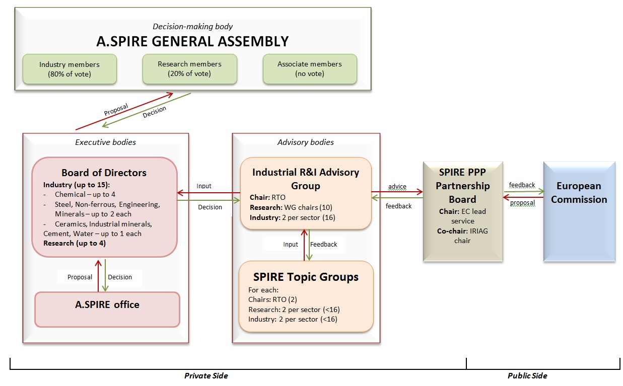
A.SPIRE organisational structure
Roadmap
Work programme
Open calls

Slide 32
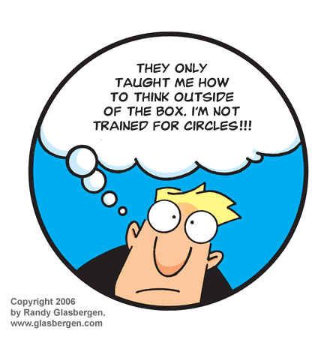
New thinking, new doing
No-one can do it alone
-> build synergies:
  across industries
  across public/private
  across borders
  across technologies

Slide 33

www.spire2030.eu
Information on awarded SPIRE projects will be also available soon on our webpages

