Slide 1

ARTEMIS, from successful R&D to cutting-edge Innovation
Rolf Ernst, TU Braunschweig
Oct. 4, 2011  Brussels
ARTEMIS Industry Association The association for R&D actors in embedded systems

Slide 2
Embedded Systems
– Key Industrial Innovation Driver
embedded systems have become
a key industrial innovation driver in the last decade
  all industrial sectors have profited
  automotive, aerospace, industrial, energy, health,
  consumer, ...
  Europe has developed a world leading position in
  embedded systems research and technology
enabled by major innovation in embedded systems technology
  from small microcontrollers to complex multiprocessor hardware and software
  from individual control units to communicating devices that jointly control cars, airplanes, buildings, production lines, ...

Slide 3
Embedded Systems
– the Neural Backbone of Society
upcoming societal challenges require a new generation of embedded systems
  large networks of embedded systems and systems-of-systems for physically widely distributed applications
  access to information system infrastructure
  built upon the existing highly developed ES technology
examples
  electric energy supply
    challenges: renewable sources, electromobility
  green mobility and transportation
    challenges: safety, energy efficiency, mobility for everyone
  health, security, ... (more in ARTEMIS SRA)

Slide 4
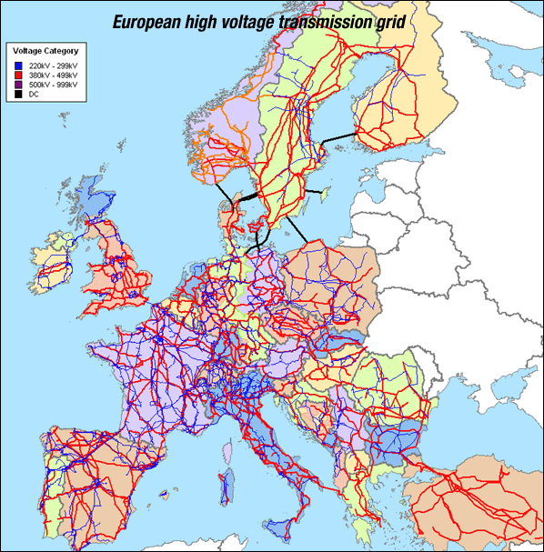
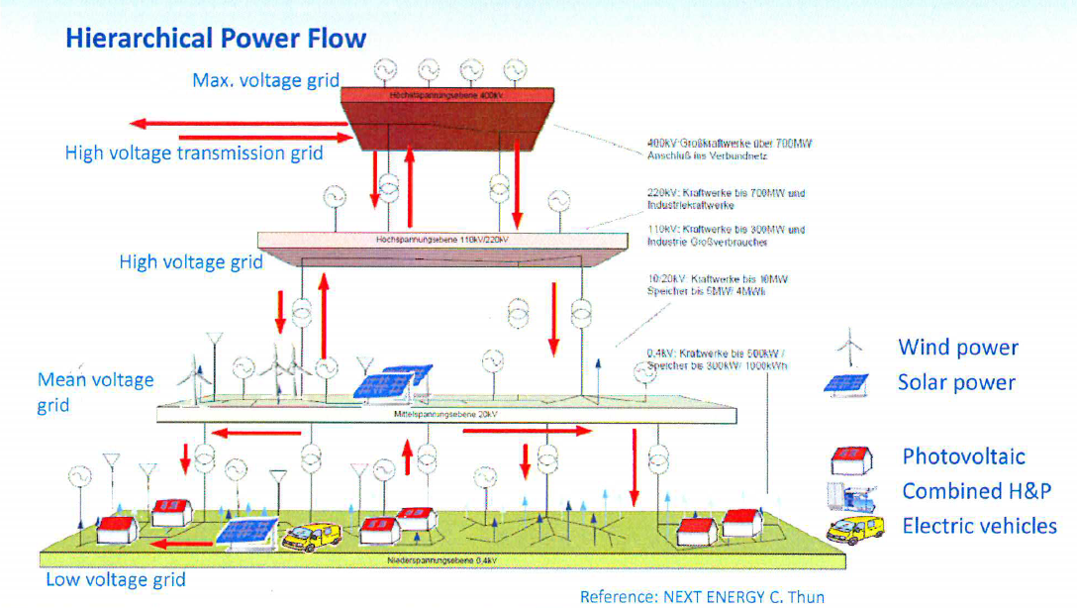
Example 1: Energy Supply - Europe
  increasing dynamics of energy producers and consumers challenges grid control requiring new solutions
  solutions are based on the embedded systems in all devices
  global power supply will depend on reliable and secure embedded computer networks spanning a continent
networked embedded systems will make the smart grid work
GTM Research: The Smart Grid in Europe 2012-2016

Slide 5
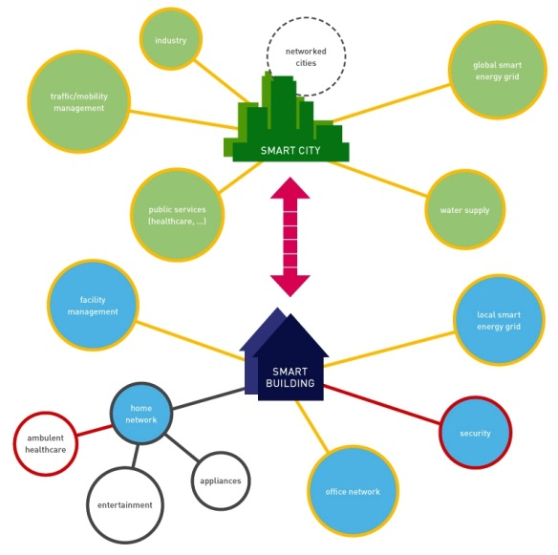
Energy Supply - City
more than 40% of the total energy consumption is spent on buildings, and a large amount is spent on city traffic
unconnected building control systems, private devices and transportation systems limit energy optimization
network integration needed as a basis for
power grid energy control
new capabilities required as next step
  decentralized coordinated city energy control
  integrated home, office, and facility networks
  integrated buildings and traffic energy control
  all based on networked embedded systems

Slide 6
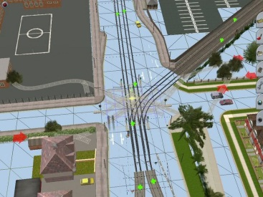


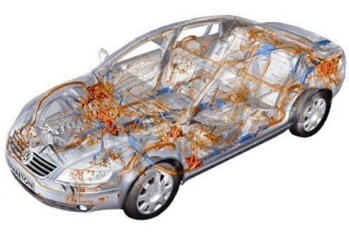

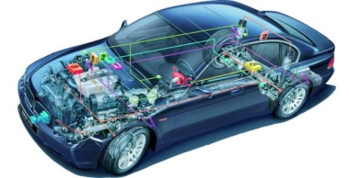
Example 2: Green Mobility and Transportation - Requirements
city level traffic
optimization
  energy, CO₂
  dynamics
traffic
management
safety
individual needs
local flow
optimization
  time
  energy, CO₂
traffic control
car2infrastr.
open
vehicle
network
local
driver assistance
body control
entertainment
communication
car2car com.
open

Slide 7
Green Mobility and Transportation
– Embedded Systems Network
traffic management
traffic control
traffic control
vehicle 1
vehicle 2
bicycle,
pedestrian,
…
ECU1
ECU2
ECUn
Internet becomes part of the embedded network
Internet
wireless local communication
in-vehicle field bus
(CAN, LIN, MOST, …)

Slide 8
Green Mobility and Transportation
– Addressing Individual Needs
Mobility for Everyone
  many people suffer from limited mobility due to extraordinary health conditions or to handicaps
  embedded system networks can help to increase mobility
    monitor, navigate, physically assist, prevent harm
  application follows person
    moves safety criticality to all embedded networks (healthcare)
    requires seamless interaction under safety and real-time requirements
work/
recreation
home
building
traffic

Slide 9
Green Mobility and Transportation
– Mobility Function Integration
Public
Infrastructure
Nomadic
Nomadic
Industrial
Public
Infrastructure
Private
Space
Industrial

Slide 10
Main Innovation Requirements
networked embedded systems technology
  robust, reliable, and predictable platforms for widely distributed systems shared by many applications
  technologies & standards bridging industries and countries
control technology
  for extremely large systems-of-systems coping with unreliable communication, such as wireless and Internet
  research: Cyber-physical systems
systems integration
  highly automated interoperability between large systems and information infrastructure including Internet of Things

Slide 11
R&D and Innovation Targets
- Selection
use of the open internet
robustness and autonomy
mixed criticality
open system design verification

Slide 12
Use of the Open Internet
Future Internet will extend its role from a backbone of information society to a communication and integration vehicle for a rapidly growing world of embedded systems
  there will be many more embedded systems using the Internet than people (40 bil./year by 2020)
  but Internet is only part of the embedded systems network – no replacement
Internet cannot reach the QoS and robustness of current local and dedicated embedded systems networks
  major challenge - must be addressed by embedded systems innovation

Slide 13
Robustness and Autonomy
  robustness requirements
    robustness against communication failures („Cyberphysical systems“)
    robustness against platform deficiencies and errors (untrusted, failing or incorrect components)
    robustness against dynamically changing system contexts and systems evolution
autonomy requirements
  autonomy for robustness
    system parts shall work autonomously in case of communication failures - home networks, medical monitoring in car, traffic control, …
    self protection against critical changes and untrusted components, …
  autonomy for dynamic change
    self configuration and adaptation for systems evolution
    semantic interoperability for systems composition/configuration

Slide 14
Mixed Criticality
using shared components and services for safety critical applications drastically increases component requirements
design processes and platform properties enforced by safety standards
  require sufficient independence of functions with different criticality
new technologies and design methodologies needed
  providing “sufficient independence” for integration
  thereby keeping efficiency, flexibility and adaptability for the non-safety parts

Slide 15
Open System Design Verification
function test of large networked embedded systems
  no complete test beds any more
  systems are only integrated in the field
  systems contain dynamically adapting components of limited trust levels
  networks are never down → test restrictions
lab tests should be supported by Living Lab integrations
  technical integration test
  societal acceptance test and showcase

Slide 16
Consequences – A case for ARTEMIS
many solutions for individual problems must be combined to address upcoming societal challenges
  no individual communication or computation technology is sufficient
realistic solutions can only be based on advancements of existing embedded systems technology
  well established world leading European technology
  existing technology is backbone of products & services
  needed innovations are possible if funding is available
European collaboration is essential for success
  societal challenges reach across industrial segments
  networks span many countries

Slide 17
Consequences – Innovation Infrastructure
ARTEMIS projects enable innovation
  they bring many companies together to reach a critical mass for innovation
  they have demonstrated to spur collaboration with leading research institutions
    to provide technology solving industrial and societal challenges
    to feed back emerging problems to research
    examples: formal methods for contracting, real-time and safety systems, embedded computer architectures, security, ...
  consider necessary time to market innovation!
ARTEMIS projects must be complemented by smaller basic research projects
  currently ARTEMIS still profits from research in FP6 & FP7!

Slide 18

Thank you for your attention!
Rolf Ernst, r.ernst@tu-bs.de
ARTEMIS Industry Association

Slide 19
Conclusion
billions of embedded systems are at the core of our technological development
they increasingly collaborate in emerging large networks forming a neural backbone of society
the successful development of these embedded system networks is key to handle the upcoming societal challenges
important technical competences must still be developed in research and brought to innovation
Future Internet, information systems, and services will help, but cannot provide most of the required core competencies and technologies

