Slide 1
The ARTEMIS programme
Progress to date and Success Stories
Eric Schutz, Executive Director ARTEMIS-JU
4/10/2011, Brussels
ARTEMIS Joint Undertaking The public private partnership for R&D in embedded systems

Slide 2
Reminder : the ARTEMIS Societal, Economic and R&D Context
Societal and Economic Context
Embedded Systems enable better use of resources, and are instrumental for other EC PPPs: Green Car, Efficient Buildings, Factory of the Future.
Embedded Systems contribute to improve innovation capabilities in Internet, and Internet of Things areas
R&D Context
To focus on downstream-oriented research and technological development with a strong market drive.
Intention to deliver prototype or demonstrator solutions with high cross-domain applicability to address specific societal needs.

Slide 3
The Strategic Context
Common objectives:
Design Efficiency
Ease of Use
High added value
Time to market
Modularity
Safety / Security
Robustness
Competitiveness
Innovation
Cost reduction
Interoperability
Application Contexts
Reference Designs & Architectures
Industrial
Nomadic Environ-ments
Public Infra-structure
Private Spaces
Foundational science & technology
Seamless Connectivity & Middleware
Research Domains
System Design Methods & Tools

Slide 4
ARTEMIS JU Sub-Programmes
ASP 1: Methods and Processes for Safety-relevant Embedded Systems
ASP2: Embedded Systems for Healthcare systems
ASP3: Embedded systems in Smart environments
ASP4: Manufacturing and production automation
ASP5: Computing platforms for embedded systems
ASP6: ES for Security and Critical Infrastructures Protection
ASP7: Embedded technology for sustainable urban life
ASP8: Human-centred design of embedded systems
Notes:
These are the specific sub-programme priorities for 2011;
A research project should specifically address the Main Goals and Approach, the Applications Relevance,
and the Cross-domains aspects of the sub-programmes, as I’M GOING TO DESCRIBE
In addition, all projects are required to satisfy general requirements AS STATED BY ALUN IN HIS PRESENTATION

Slide 5
ARTEMIS – Vital Statistics After 3 Calls
The Finances
Total research effort committed: 568,5 €M
Total National funding committed: 182,0 €M
Total JU funding committed: 94,9 €M
Total Public funding: 276,9 €M
Total Industry input: 291,9 €M
Average total funding rate: 48,7%

Slide 6
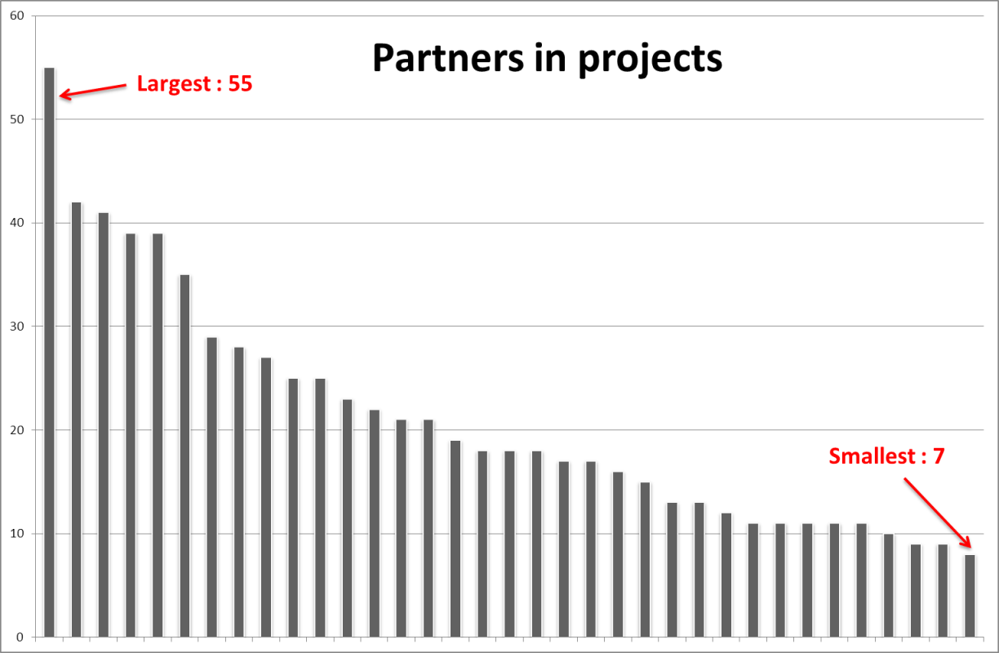
ARTEMIS – Vital Statistics After 3 Calls
The Projects
Total projects: 35
Average cost / project: 16,2 €M
Largest project “CESAR” : 58,5 €M (55 partners)
3 “SME + PRO Only” projects

Slide 7
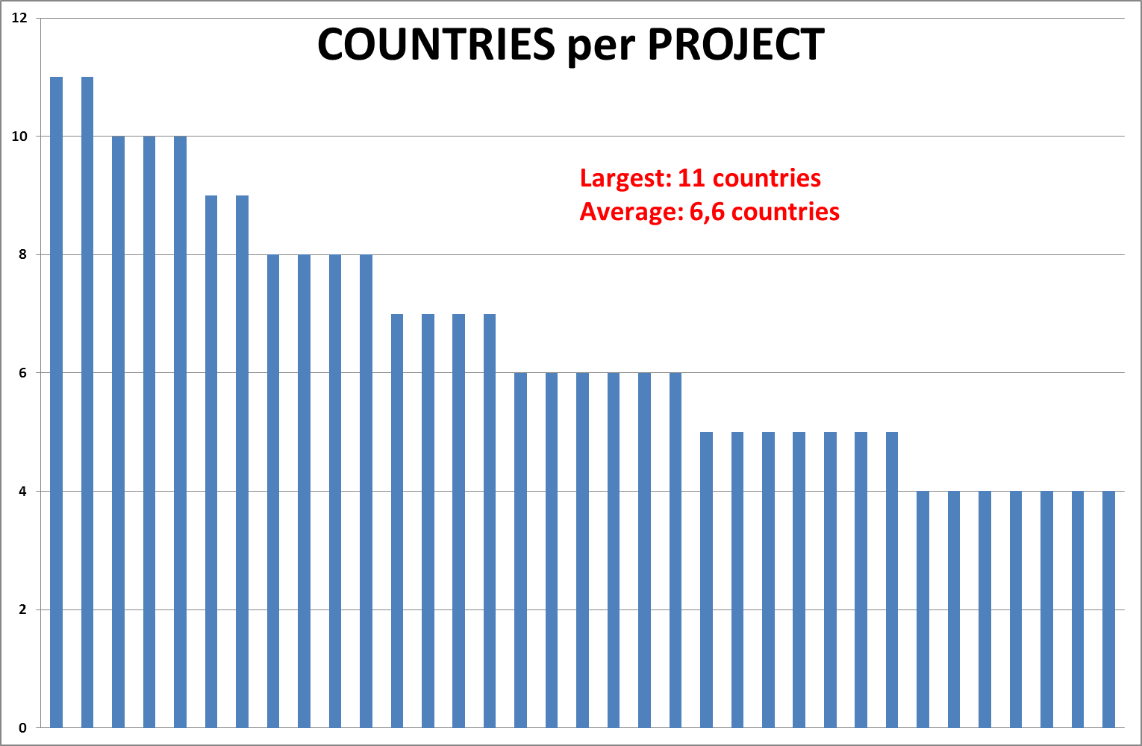
ARTEMIS – Vital Statistics After 3 Calls
Integration and buy-in of European expertise in projects with major impact

Slide 8
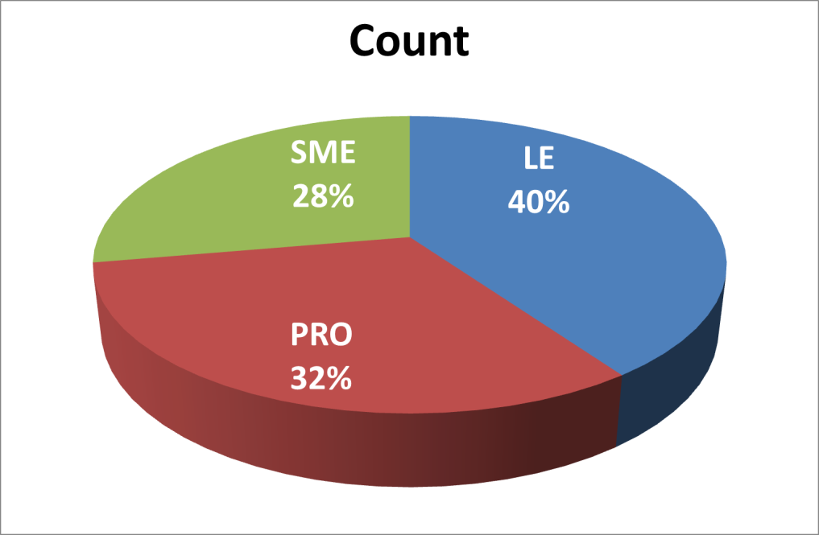
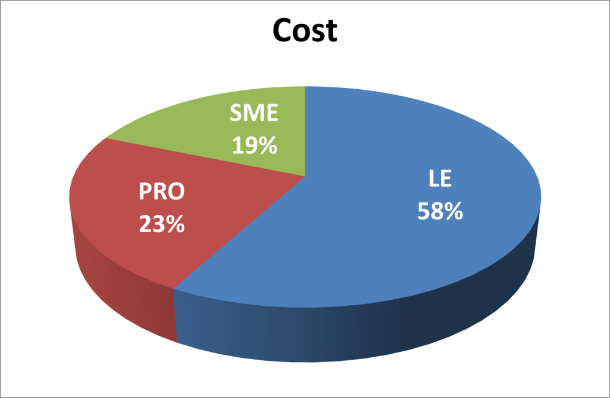
ARTEMIS – Vital Statistics After 3 Calls
The Participants
By count – LE: 297 SME: 205 PRO: 237 (tot 739)
By costs – LE: 329,1 €M SME: 106,4 €M PRO: 132,98 €M

Slide 9
ARTEMIS – plotting the route to successful innovation
The ARTEMIS strategy addressing the vision of the SRA
ARTEMIS = achieving European scale Market Innovation
Through “Self-sustaining Innovation Ecosystems“ and Centres of Innovation Excellence – CoIE
Four concepts for building “critical mass” around specific markets / applications
“Think Big” – High-impact projects, clustering, “community”
“Act Socio-Economic” – Address societal and/or industrial needs
“Act Multi National” – Valorise rich expertise from across Europe
“Think Different” – Creative added-value, including ways to work
Notes:
9

Slide 10
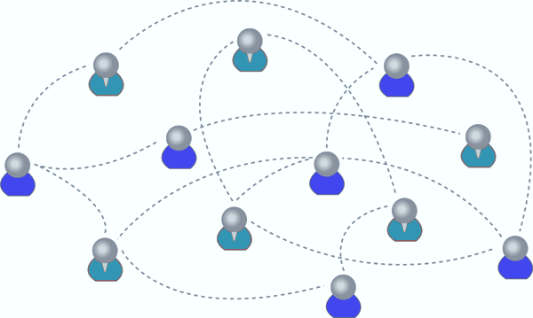
Funding of R&D is a strong “network enabler”. So? What’s new?
Europe has a strong history of R&D collaboration
Semiconductor industry is a shining example
>22 years of close, pre-competitive collaboration!
ARTEMIS recognises the following needs:
Product innovation benefits from dynamic, ad-hoc and focussed networks
These produce “dominant designs” from new technologies
Market innovation benefits from larger, structured networks
Take “dominant designs” to become viable, competitive market players, integrate a broad scope of “Complementary Assets”
Critically important for Embedded Systems that interact closely with society (safety, standardisation, certification, regulation, …).
ARTEMIS envisions “Self-sustaining Innovation Ecosystems” as the embodiment of these vital, structured networks
Sub-programmes and Projects seed such ecosystems
Formalised into CoIEs

Slide 11
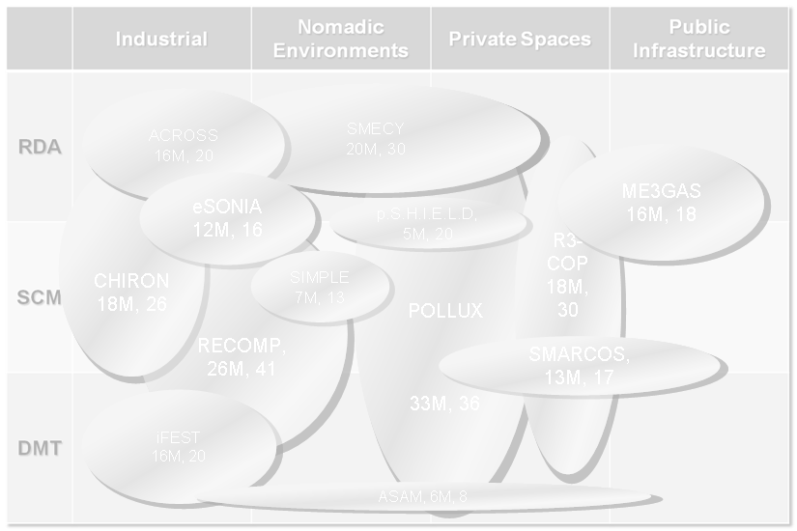
ARTEMIS-JU – the status after 3 Calls
Major eco-systems are already crystallising from ARTEMIS-driven developments
Four clear areas already emerging
Safety and reliability
Electric Vehicle
Low-power Multi-Core for embedded
Energy efficient communities (buildings and districts)
Others on their way
Person-centric e-Health
The “things” of the Internet (for the Internet of Things)
Green, efficient and competitive manufacturing

Slide 12
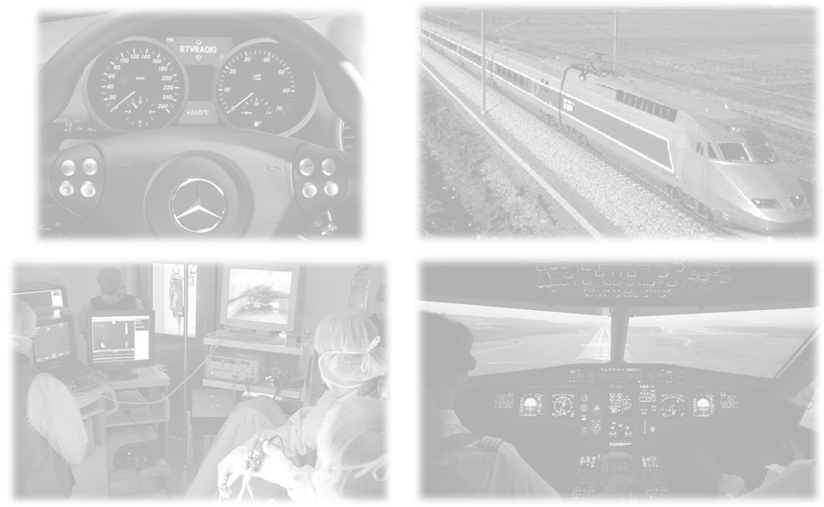
Safety and reliability
“High reliability electronics is expensive”
But… “Low reliability” is not an option
Expensive automotive re-call actions
High visibility accidents
Undermines consumer/social acceptance
ARTEMIS High-rel cluster to make full dependability affordable and improve competitiveness
Keep the “Cachet” of European quality at realistic prices

Slide 13
The ARTEMIS High-rel cluster
Grows around the Sub-Programme 1
Defined and contributed to by the EICOSE cluster
Cooperation of French and German “Centres of Excellence”
Projects CESAR, RECOMP, MBAT, pSafeCer, iFEST
Define and develop processes and tools for building ultra-reliable electronics at competitive costs
The “invisible shield” protecting the end user
Common goal – Europe as the quality reference
Share many of the same leading European industrial companies

Slide 14
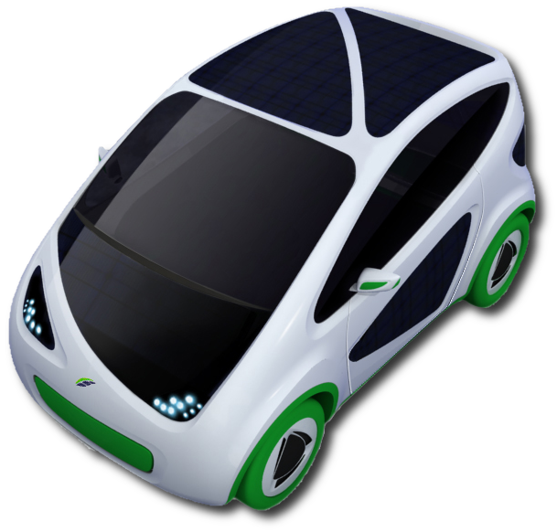
ARTEMIS Building the future of the Electric Vehicle
The JTI “Think Big” model has inspired major players to coordinate R&D efforts
Non-differentiating enabling technologies
Common roadmap for the sector
… across many funding schemes
ARTEMIS, ENIAC, ITEA2, EPoSS, National, …
Feeds into other major initiatives
Green Cars Initiative
Fuel Cells and Hydrogen JTI
…
ARTEMIS project POLLUX (complemented by IoE – Internet of Energy) plays a leading role

Slide 15
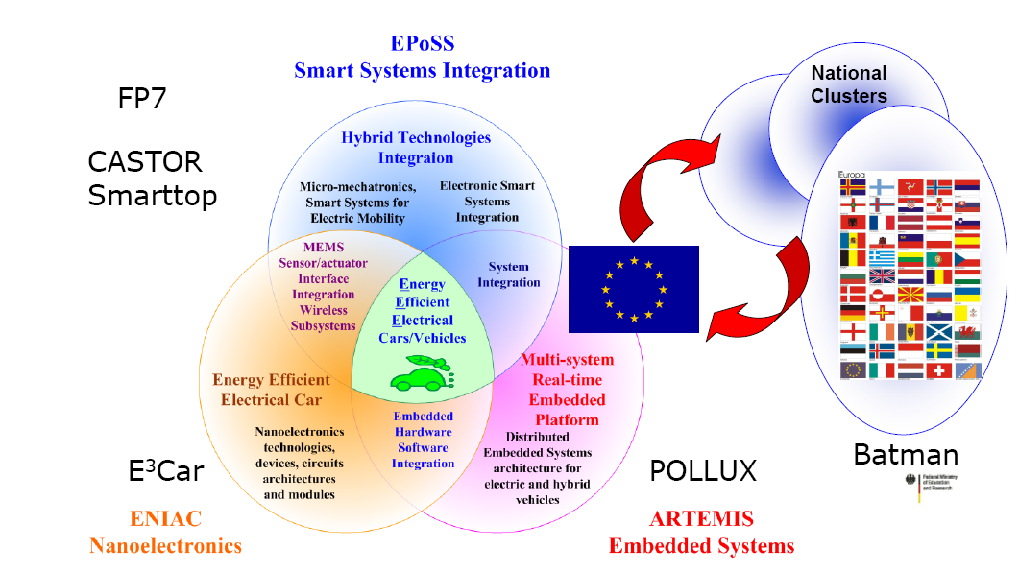
European Electric Vehicle initiatives

Slide 16
Low-power Multi-core for Embedded
Pushes the envelope for computing speed versus power consumption
Most high-profile “Embedded” apps require lots of processing with little power, for long battery life (or, no battery at all).
Fundamentally opposed objectives
Low Power concerns are NOT only for hardware design
Hardware platforms abound, but VERY complex issues for software and system design
Much (fragmented) work has not yet provided any optimal solution
ARTEMIS’ goal of reducing fragmentation addresses this
If there is one enabling technology that can make a major impact
THIS IS IT.

Slide 17
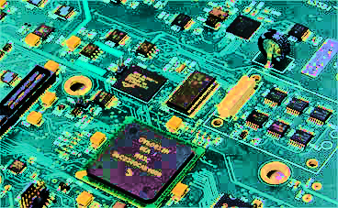
ARTEMIS and multi-core
ARTEMIS is already bringing together many activities
Around software architectures
Around (system) development tools and methods
Some major projects lead the way
low-power for mass-market products (SCALOPES)
extended multi-core design (SMECY)
Supported by several smaller, targeted initiatives:
INDEXSYS and ACROSS (fed from FP7 project “Genesys”)
iLAND, ASAM
SCALOPES led the first “ARTEMIS Technology Conference”
Budapest, June 2010
Starts to build a strong community of expertise

Slide 18
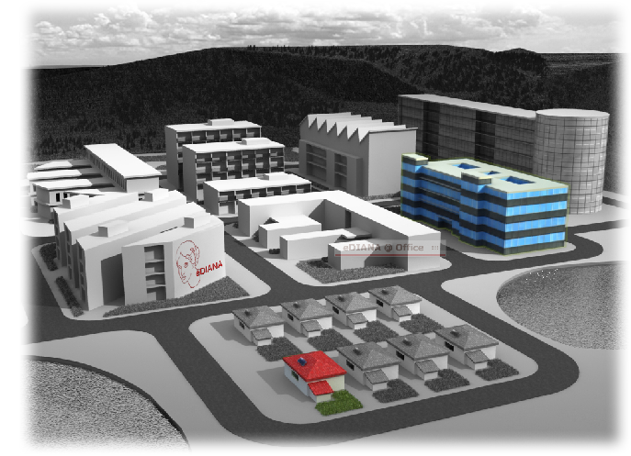
Energy Efficient Communities
Goal – reduce our carbon footprint without conceding comfort and safety
Project eDIANA sets the scene
Controlling a single heating system may be easy, but scaling this to complete buildings and even communities is a major barrier
eDIANA brings some key players together around a standardised architecture to
Facilitate retrofit (big concern)
Guarantee lifetime support (big concern)
eDIANA proposes an ARTEMIS CoIE
Complemented by projects IoE (Internet of Energy) and ME3GAS
These major initiatives will have a significant impact on the energy-efficiency of our future society.

Slide 19
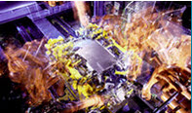
Other major ARTEMIS clusters
eHealth: CHIRON, HIGH PROFILE
“Things of the Internet”: SOFIA, SIMPLE
Manufacturing: eSONIA, R3-COP

Slide 20
Impact multiplication
These ARTEMIS projects are like no others…
Large, well coordinated activities drawing on best-in-class European expertise
Complemented by smaller, targeted initiatives
Ideal seeds for top-class CoIEs!

Slide 21
Conclusion :
ARTEMIS = the only true pan-European R,D &I programme for electronic systems
designed by the European Industry
for the European Industry
promoting the involvement of SMEs

Slide 22
Thank you for your attention!
Eric.Schutz@artemis-ju.europa.eu
ARTEMIS Joint Undertaking The public private partnership for R&D in embedded systems

