Slide 1
ARTEMIS as seen by Industry
Jan Lohstroh,
Secretary General
ARTEMIS Industry Association
2011, October 4
ARTEMIS Industry Association The association for R&D actors in embedded systems

Slide 2
ARTEMIS Community
When we speak about ARTEMIS we speak about a community:
ARTEMIS Industry Association
ARTEMIS Member States
European Commission
ARTEMIS platforms
ARTEMIS R&D projects
ARTEMIS
Joint
Undertaking
Notes:
The ARTEMIS Industry Association collaborates with 22 ARTEMIS Member States and the European Commission to boost innovation in Europe. The legal embodiment of this cooperation is called the ARTEMIS Joint Undertaking.
ARTEMIS wants to help European industry consolidate and reinforce its world leadership in embedded computing technologies. The economic impact in terms of jobs and growth is expected to exceed € 100 billion over ten years.

Slide 3
Notes:
ARTEMIS teams up with the ITEA community at the annual Co-summit events (this year on 25 & 26 October) and with the sister Joint Technology Initiatives in Brussels at the joint JTI-event on 4, 5, 6 October.

Slide 4
ARTEMIS Industry Association
Member status ARTEMIS Industry Association October 2011
A  SME members
68
B  Public Research members
101
C  Corporate members > 500 M€€
32
C  Corporate members < 500 M€
6
◆ Associates
10
TOTAL members
217
Notes:
The association is organised in Chambers. Chamber A, Chamber B, Chamber C and Associates. Every Chamber has a Coordinator. The members work together in Working Groups on a honorary basis. For an extensive overview of the ARTEMIS members I refer to the website.

Slide 5
ARTEMIS: the Industry Association
Is ‘the’ association for all R&D actors in embedded systems and is unique in Europe
ARTEMIS Industry Association continues the activities of the ARTEMIS European Technology Platform started in 2004
Members define and update the ARTEMIS Research Agenda for Europe…
The association represents the Industry in the ARTEMIS Joint Undertaking
Notes:
Europe, with its world class automotive, aerospace, communication, and medical equipment industries, still has an excellent position in Embedded Systems, which play a key role in enhancing the capabilities, availability and usefulness of these products. Only through adequate coordination and collaboration and with the help of public funding can this position be maintained to help solve the enormous societal challenges and, at the same time, spur European competitiveness in many areas. The members of ARTEMIS Industry Association define the research compass for the innovation, research & development of embedded systems in Europe.

Slide 6
Notes:
Societal challenges are an overarching concept that will drive European competitiveness, with several application and research domains contributing to each societal challenge. ARTEMIS addresses all societal challenges nonetheless the highlight on three major challenges.

Slide 7
Notes:
In June 2011, the ARTEMIS Industry Association launched a new version of the ARTEMIS Strategic Research Agenda. This new version was based on the first SRA that had been launched in 2006.

Slide 8
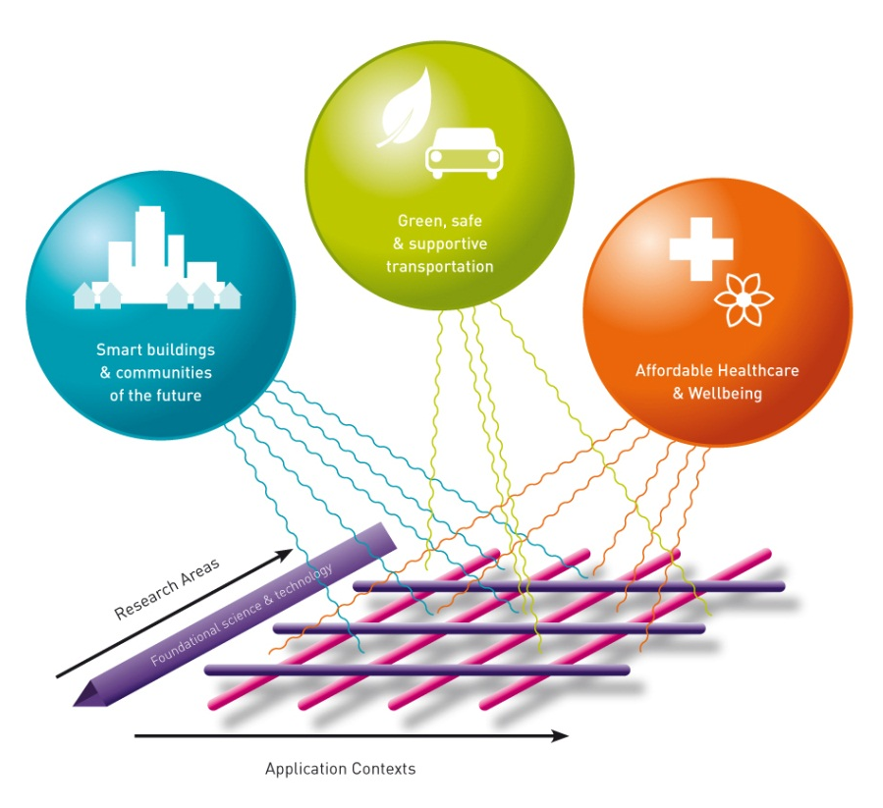
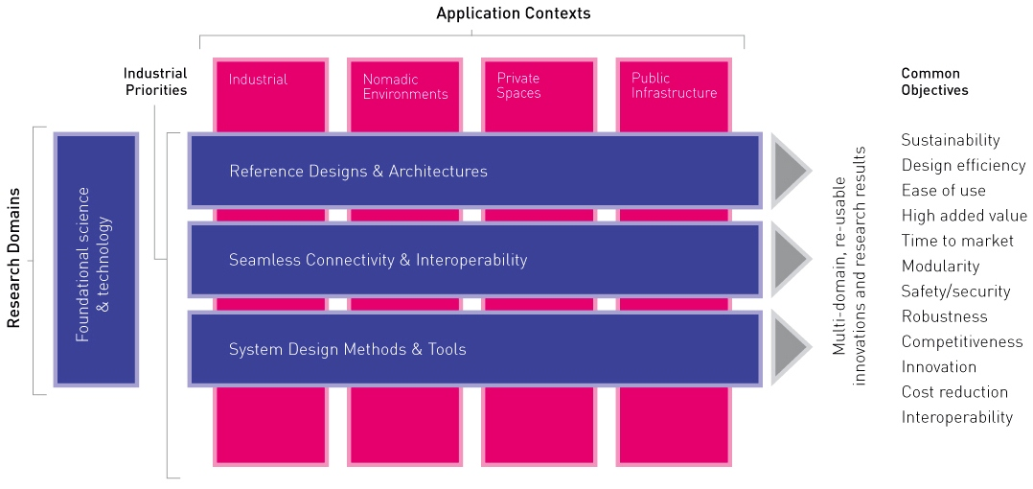
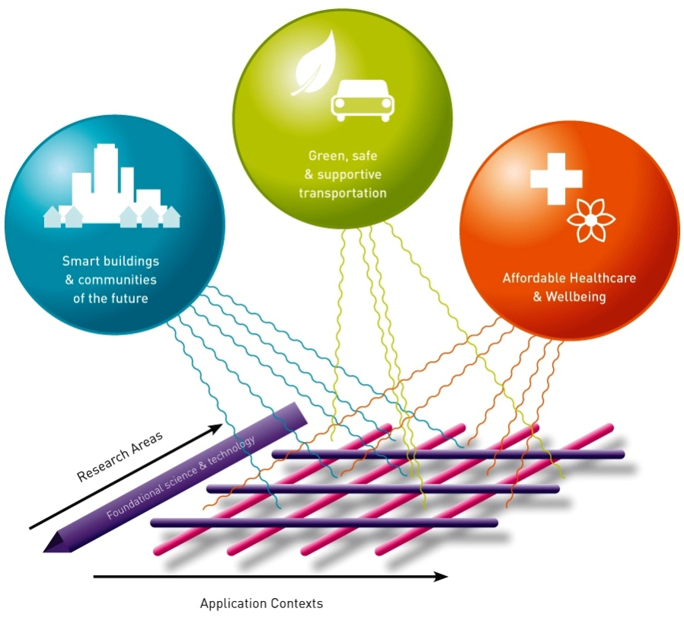
ARTEMIS Strategy
Notes:
The HORIZONTALISATION to overcome the fragmentation, while mastering the complexity, for yielding multi-domain reusable results.
A new three dimensions approach to achieve multi-domain compatibility, for cross-domain approach to support a variety of applications, services as solutions for societal challenges . Achieve a paradigm change : big impact and quick to market

Slide 9
Make it happen The differentiators
Working Group Centres of Innovation Excellence
The scope of a CoIE is that of a coherent subspace of an application domain of the ARTEMIS SRA. It creates an Innovation Eco-system for that subspace, taking advantage of the critical mass of competences and resources that have already been organised in its supporting regional clusters
Notes:
[WG] Centres of Innovation Excellence
Focus on a small number of systems oriented CoIE of multi-disciplinary nature to pursue implementation of industrial research visions and mobilise critical mass
Continue to build on regional clusters to integrated them to ARTEMIS innovation environment
Facilitate the transformation of research results into industrial development

Slide 10
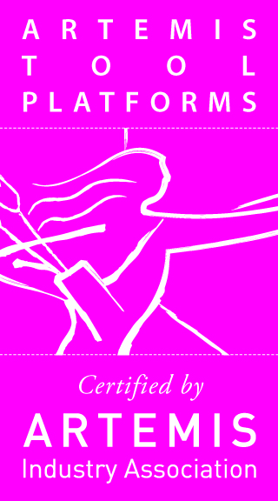
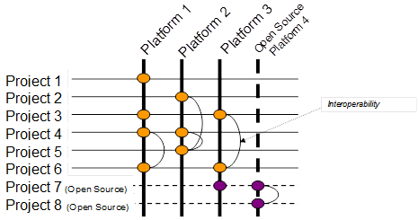
Make it happen The differentiators
Working Group Tool Platforms

Slide 11
ARTEMIS Joint Undertaking is a success
Current Joint Undertaking
A new initiative with a strategic top-down approach is up and running with a big value for Europe based upon a well supported SRA
The industry driven projects have a large footprint with a rich content addressing societal needs
Combining strengths of many players (industries, small and big, and knowledge institutes) targeted to improve R&D and innovation efficiency in Europe
Impact and visibility of embedded systems in Europe has increased
ARTEMIS 2?
Lessons learnt should be taken into account
Some disadvantages to be addressed

Slide 12
ARTEMIS ‘2’?
Networked Embedded Systems are THE NEURAL SYSTEM OF SOCIETY
In a global world Embedded Systems are a crucial KEY ENABLING TECHNOLOGY for Europe’s industrial and societal future, and one that must not be underestimated or overlooked
A successor programme, following the final call of the current Joint Undertaking in 2013, is essential if Europe is to achieve the level of competitiveness needed to keep it ahead in the global race for ICT based solutions to societal challenges as targeted by the European Digital Agenda

Slide 13
Thank you for your attention!
ARTEMIS Industry Association The association for R&D actors in embedded systems

